Slide 1
Resolution Writing
Best Delegate
Model United Nations

Slide 2
The Stages of MUN
Research
Debate
Negotiate
Resolution
Action
Notes:
A typical Model UN conference (in the US) has 5 parts.

Slide 3
Goal
By the end of this lesson, you should understand how to write a resolution.

Slide 4
Resolutions
A resolution is a written document that contains your caucus bloc’s solutions to the Topic.
Your goal in Model UN is to work with your caucus bloc to write and pass a resolution.

Slide 5
Resolutions
A resolution is one long sentence with three parts:
Header
Preambulatory Clauses
Operative Clauses
Follow along on Page 75.

Slide 6
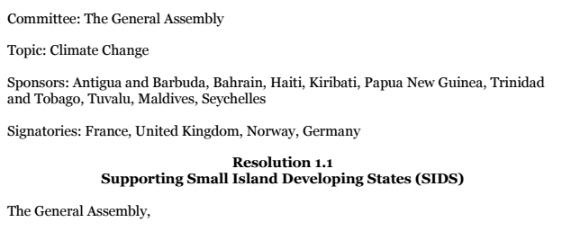
Header
Notes:
Point to the Header in the workbook

Slide 7
Header
The Header contains the following:
Committee
Topic
Sponsors: Countries who helped write and support the resolution.
Signatories: Countries who want to see the resolution presented but are not sure if they agree with it yet.

Slide 8
Header
Conferences require a minimum number of Sponsors and Signatories
MUNI: 20% of committee should be a sponsor or signatory of each resolution
You should try to be a Sponsor of one resolution
You should ask others to be Signatories
You can be a Signatory for multiple resolutions sponsored by others

Slide 9
Header
The Header also contains the following:
5. Resolution number (given by Chair)
6. Title of resolution
7. Main UN committee that you’re proposing the solutions from
Ex: “The General Assembly,”

Slide 10
Practice
We’re going to write a simple resolution on Climate Change on Page 79. Start with the Header:
Committee
Topic
Sponsor (your country name)
Signatories (leave blank for now)

Slide 11
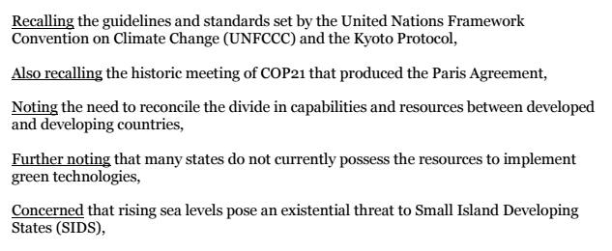
Preambulatory

Slide 12
Preambulatory
The purpose of Preambulatory Clauses is to:
Identify problems you plan to solve
Recall past international actions

Slide 13
Practice
Let’s write a Preambulatory Clause on Page 79
First, describe a Climate Change problem you want to solve in one complete sentence
Add a Preambulatory Phrase from page 78 at the beginning of that sentence that describes how your country feels about the problem.
Notes:
Use page 77, Recommended Phrases

Slide 14
Practice (continued)
Formatting:
3. Underline the Preambulatory Phrase
4. End with a comma

Slide 15
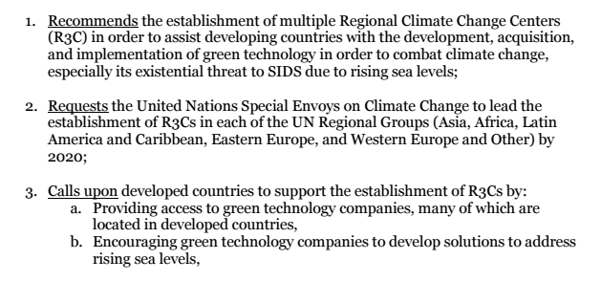
Operatives

Slide 16
Operatives
The purpose of Operative Clauses is to recommend solutions to issues.
You should ideally have more Operative Clauses than Preambulatory Clauses -- more solutions than problems!

Slide 17
Practice
Let’s write a Operative Clause on Page 80
First, describe a solution to the problem you chose in one complete sentence
Add an Operative Phrase from page 78 at the beginning of that sentence that describes what action needs to be done to implement that solution

Slide 18
Practice
Formatting:
3. Underline the Operative Phrase
4. Number the Operative Clause
5. End with a semicolon
*Note: The last Operative Clause ends with a period instead of a semicolon

Slide 19
Practice
Use the worksheets on pages 81-82:
Partner with the person next to you.
Try to write at least two more Preambulatory Clauses with your partner.
Try to write at least four more Operative Clauses with your partner.

